Slide 1
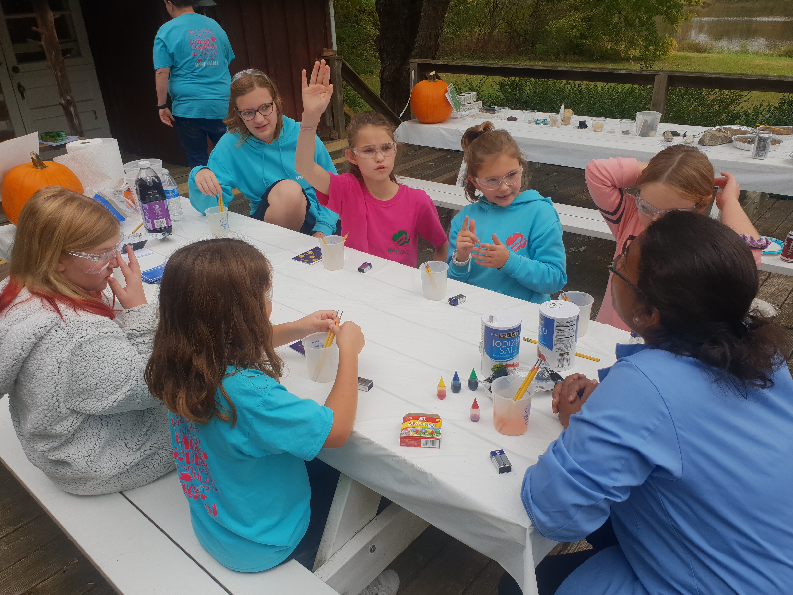
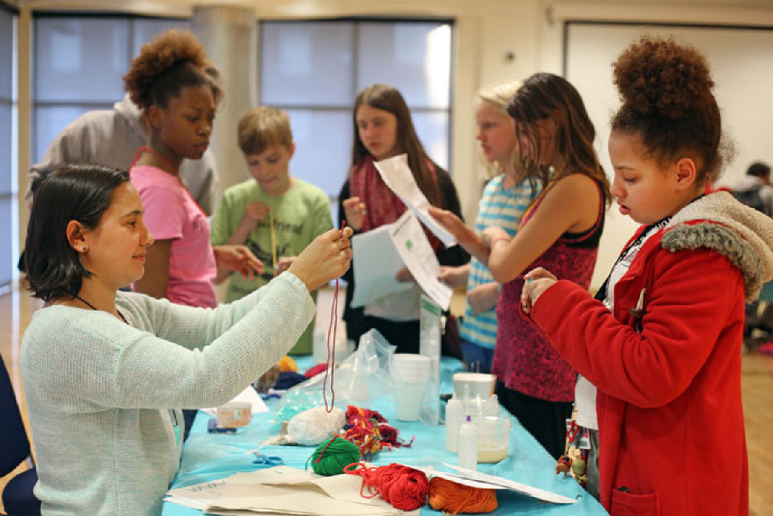
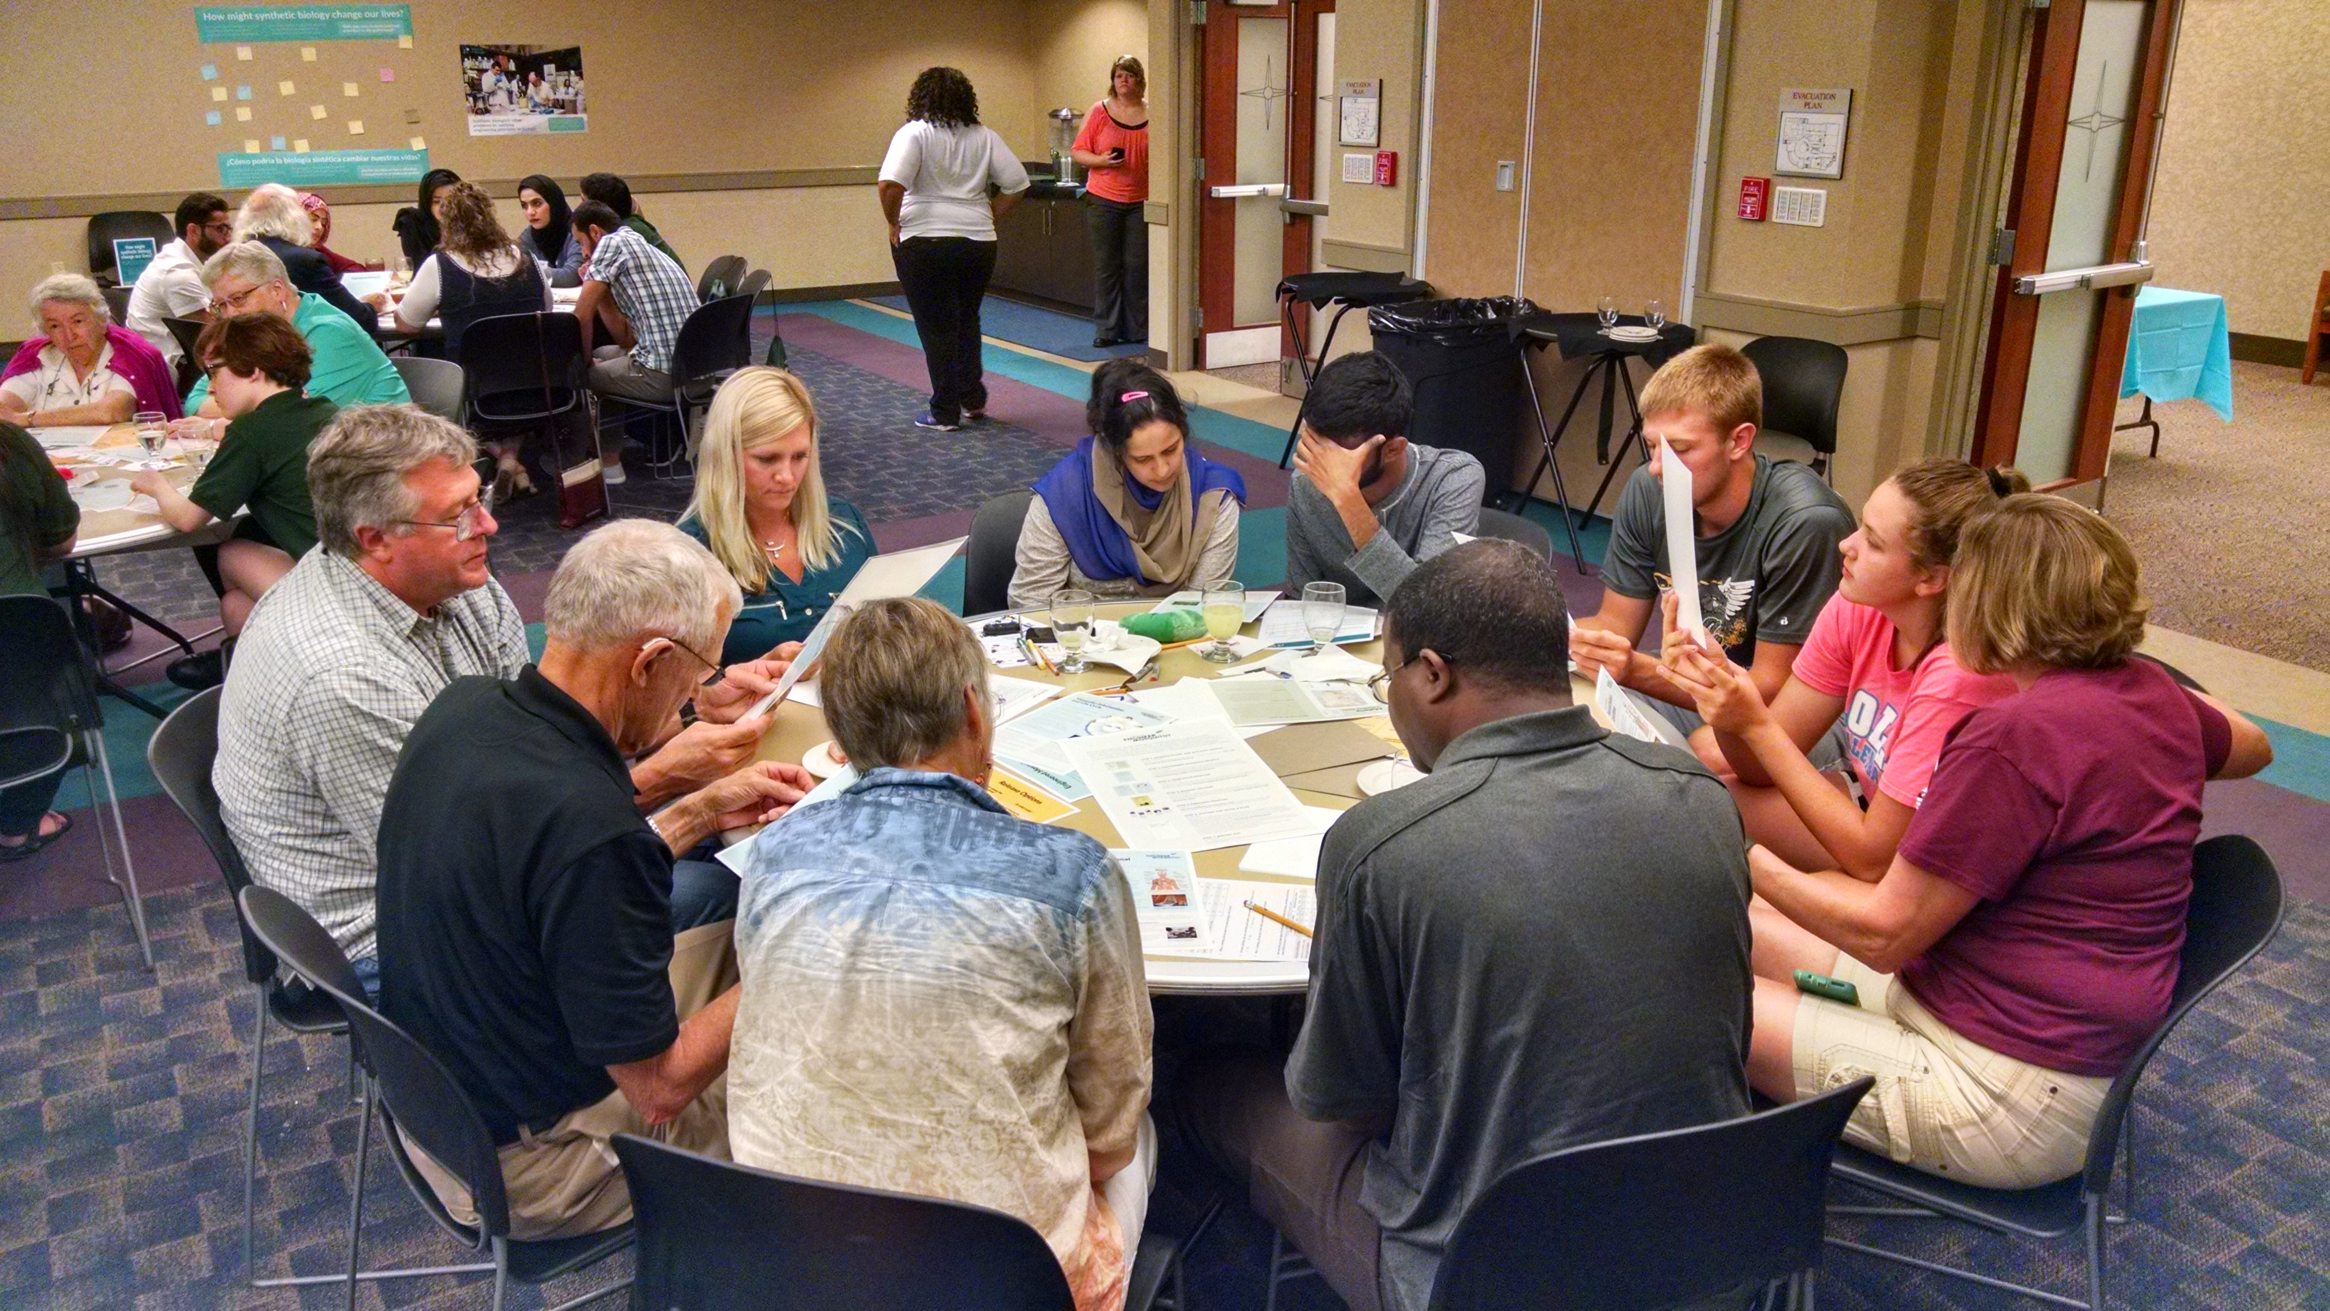
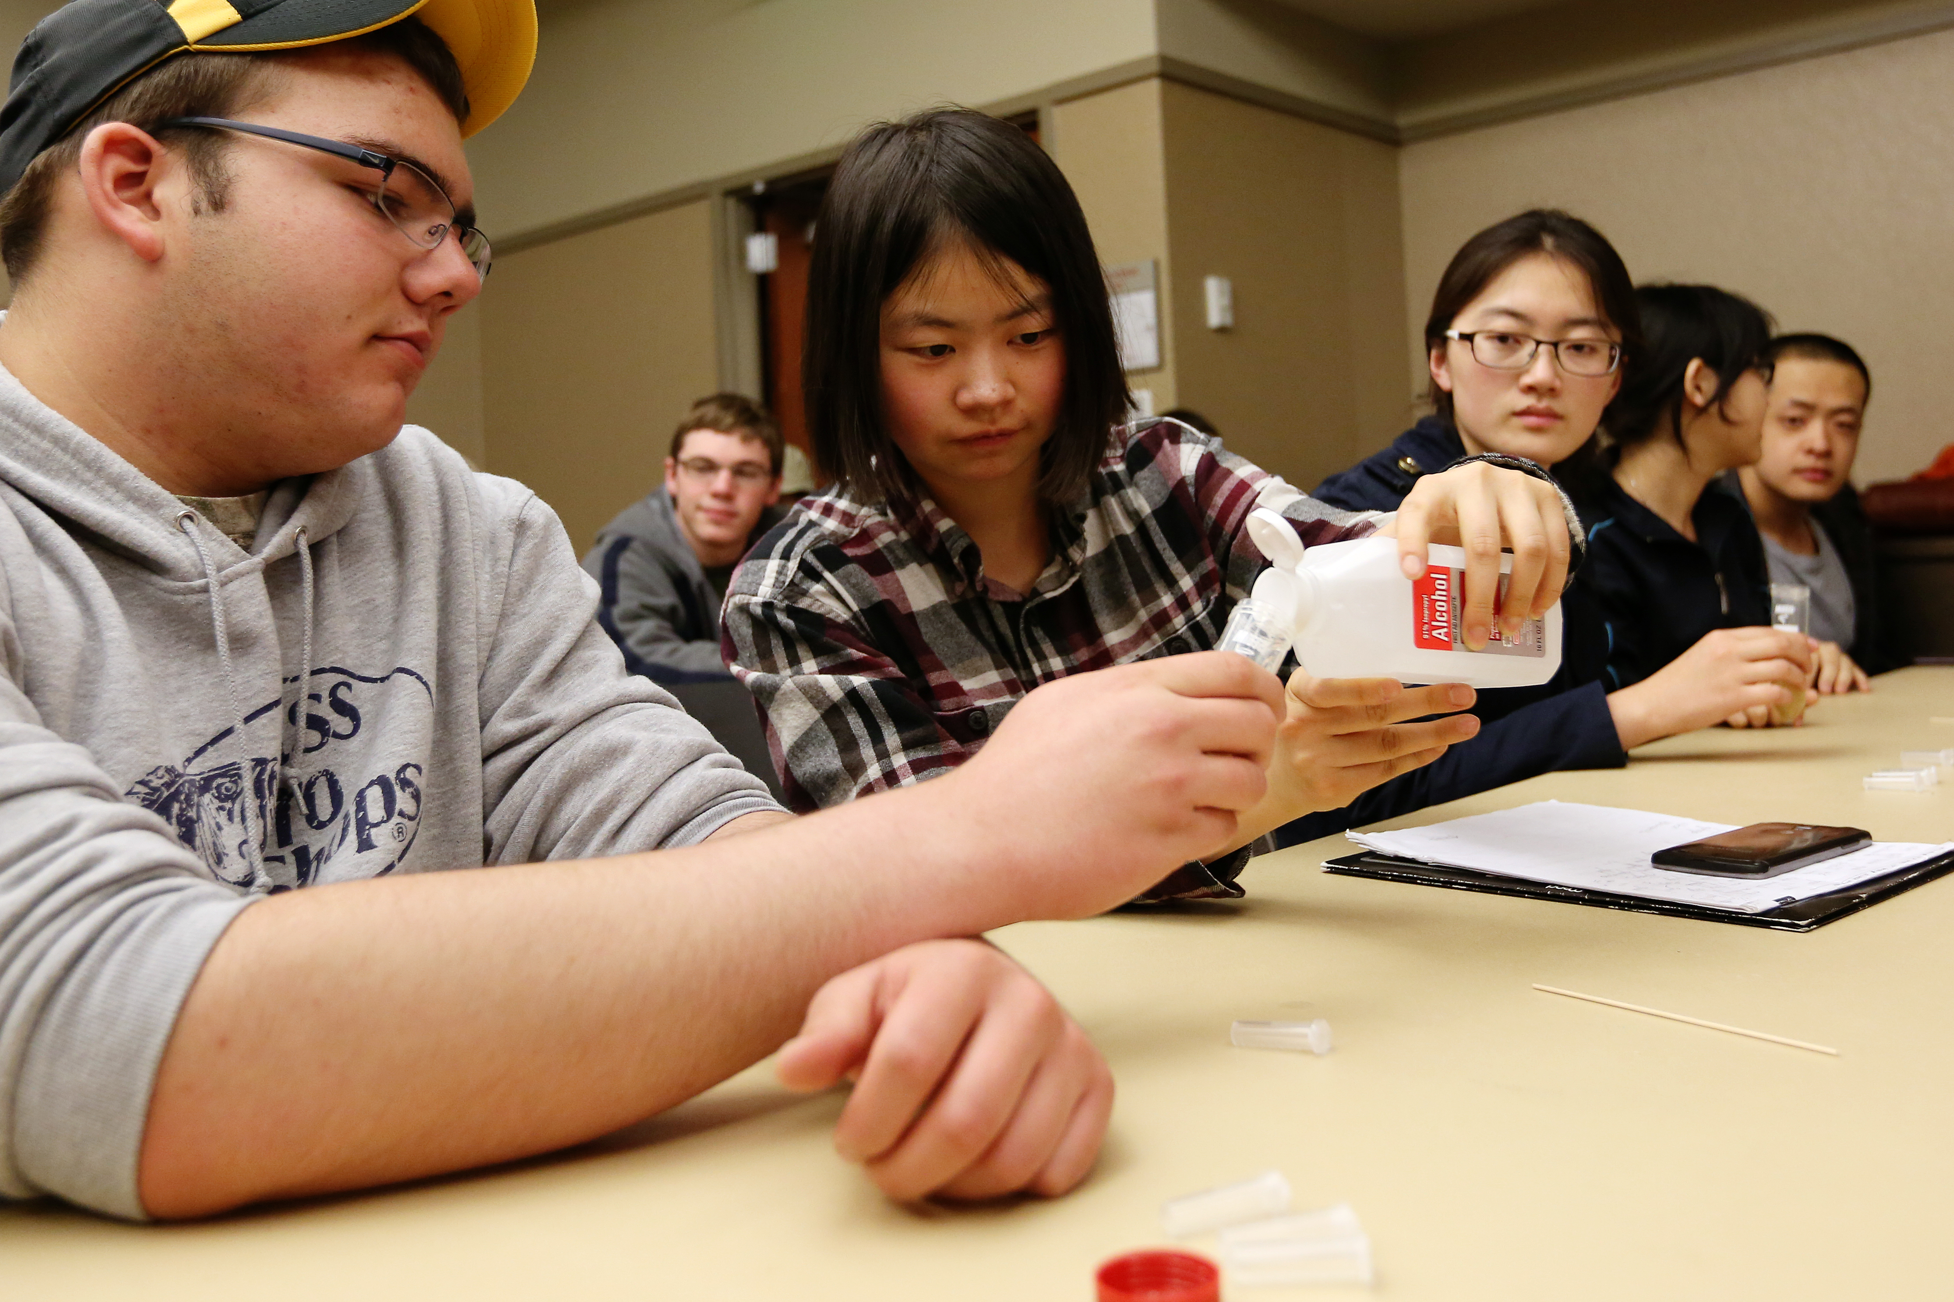
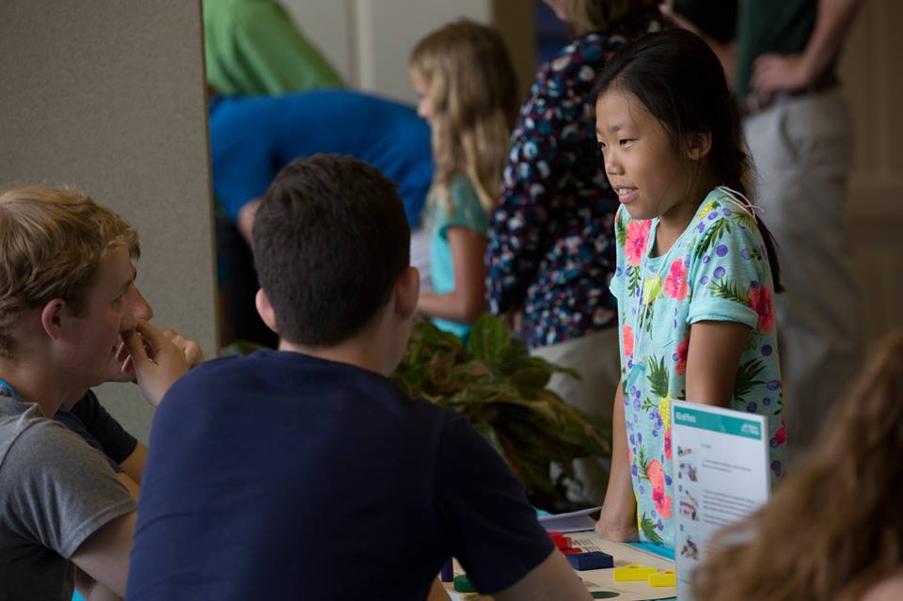
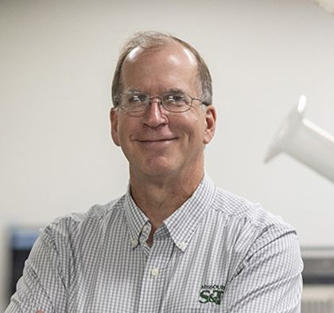
DEPARTMENT OF BIOLOGICAL SCIENCES
Microbiology Education and Public Engagement with Science
Research Interests
Microbiology education
Assessment of active learning strategies in STEM education
K12 Education and Outreach
Public Engagement with Science
Public perception of synthetic biology
Soybean/Bradyrhizobium japonicum symbiosis
Drought tolerant symbiotic bacteria
Quorum sensing in symbiotic bacteria
Novel quorum sensing molecules
Anti-bacterial treatments
Characterization of anti-bacterial materials
Development of anti-bacterial materials
Dave Westenberg
Curators Teaching Professor
Biological Sciences
djwesten@mst.edu
http://sites.mst.edu/djwesten
573-341-4798
Funding
Missouri Department of Higher Education, National Science Fdn, USDA, Missouri Soybean Merch. Council
Keywords
Synthetic biology, Microbiology Education, Public Engagement with Science
Recognitions/Significant Achievements
HHMI Biointeractive Teaching Ambassador
College of Arts, Science, and Education Dean’s Medal
American Society for Microbiology Carski Award
UM President’s Award for Community Engagement
Academy of Sciences St. Louis Science Educator Award 2017

